Slide 1
语言服务项目管理 Content Management
Unit 1 技术传播与技术写作简介
Intro to TC&TW
(Based on various resources including Gao Zhijun’s PPT, Credits to Mr. Gao)

Slide 2
Contents
技术写作
技术传播
中外技术传播行业

Slide 3
3 questions to go
How many of you want to be translators or interpreters? And why?
If not, what do you want to do?
What’s the relationship of Content Management and Translation? Can you guess?

Slide 4

Lack of Creativity

Slide 5
技术写作
Technical Writing(TW)

Slide 6
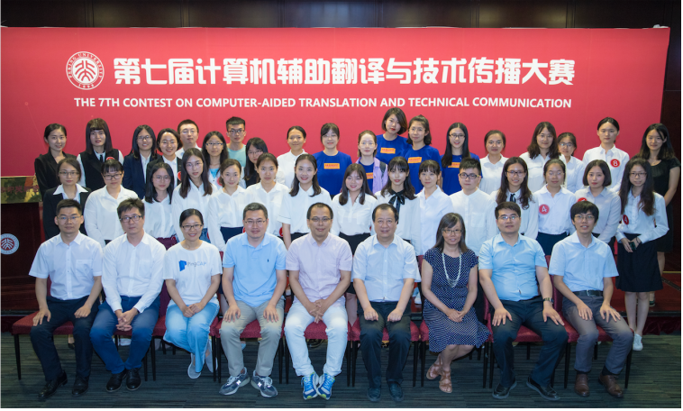

Slide 7
写作对大家来说并不模式，我们每天都会有很多写作任务，根据目的和读者的不同，常常有如下分类：
创意写作（ Creative Writing ），打动人的心灵
文案写作（Commercial copy writing)，卖东西
商务写作（Business writing)，管理人员
科学写作（Scientific writing)，记录和分享科学发现
技术写作 (Technical writing)，解释工作原理、指导用户完成特定操作
技术写作伴随着工业时代而产生，随着设备越来越复杂，以及机械设备的全球使用，提供各种技术资料的形式帮用户使用文档是非常常见的。在新媒体时代到来之前，通过文字的形式给用户提供帮助是最常见的形式。即便是今天，考虑到信息的可即性(Accessbility)，传统的说明书依然是各类产品的标配，各类产品标准中也都会相应的规定。

Slide 8
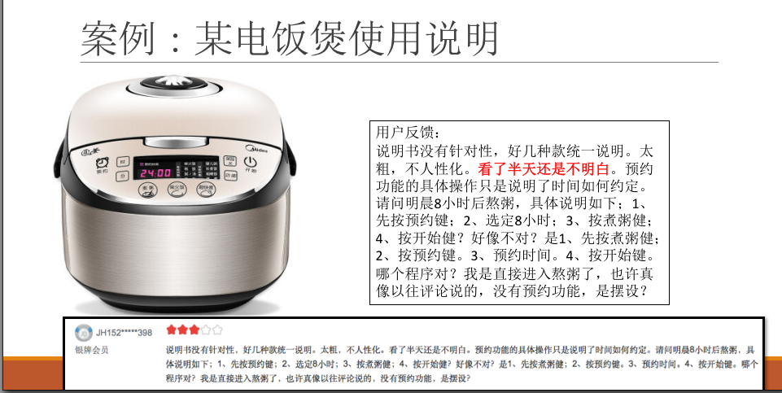

Slide 9
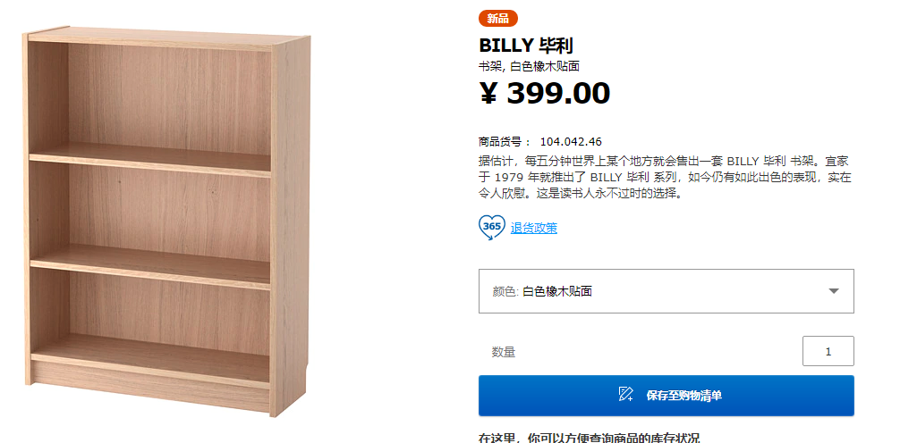
IKEA
https://www.ikea.cn/cn/zh/catalog/categories/departments/living_room/10382/

Slide 10
IKEA

Slide 11
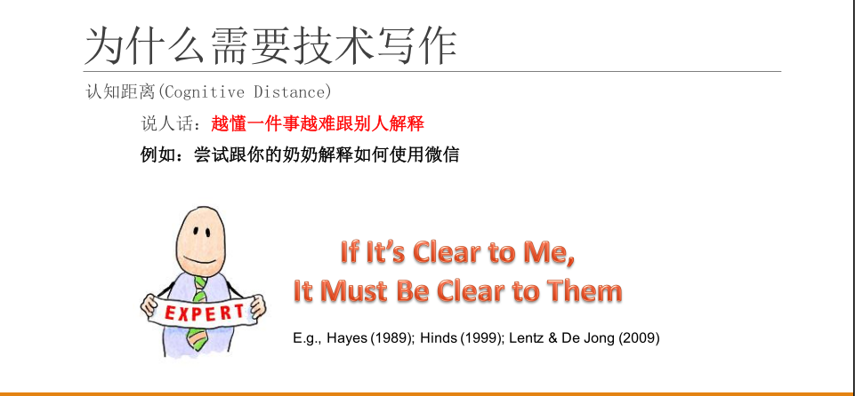

Slide 12
试着将这个介绍给你奶奶？
http://pvp.qq.com/web201605/advice.shtml

Slide 13
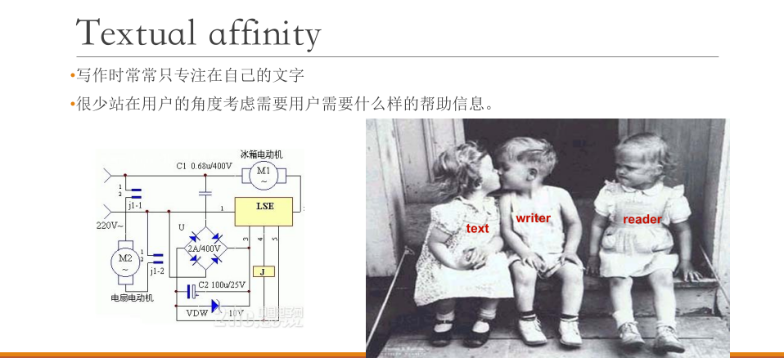

Slide 14
What is Technical Writing?
Technical writing is writing that helper users to solve problems with technologies and technologies and technical subject matter.

Slide 15


Slide 16
Types of TW
Letters
Memos
Emails
Brochures, Pamphlets and Fact Sheet
Instructional Material
Reports
Proposals
Other Media(CD, DVD, web pages…)

Slide 17
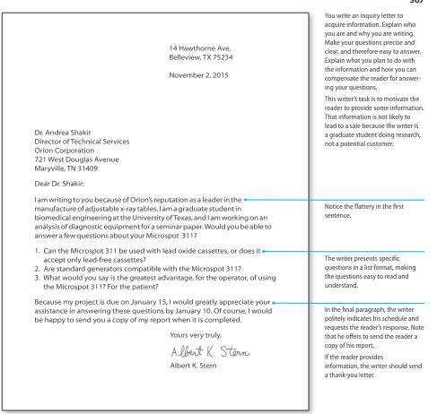

Slide 18
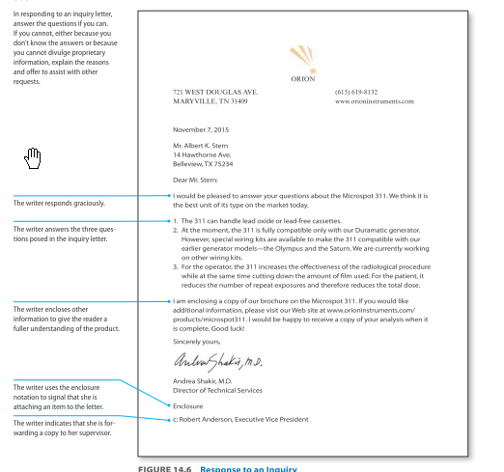

Slide 19
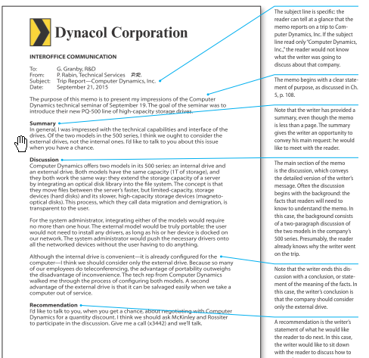

Slide 20
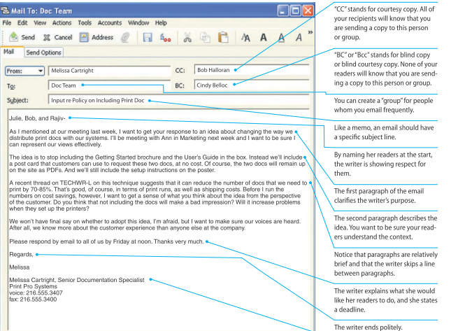

Slide 21
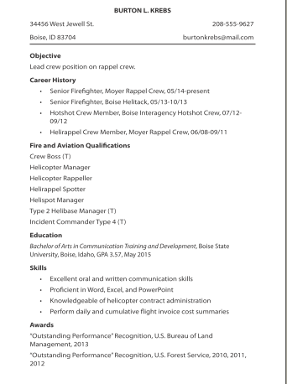

Slide 22
Manuals
http://write.flossmanuals.net/summary-of-firefox/introduction/
https://code.visualstudio.com/docs
https://help.apple.com/iphone/11/#/iph72dbdbd42

Slide 23
Wiki…
https://zh.wikipedia.org/wiki/%E6%8A%80%E6%9C%AF%E4%BC%A0%E6%92%AD
https://www.wikihow.com/Make-Calls-with-the-Apple-Watch
https://www.zhihu.com/question/265718908/answer/299752578
https://www.ifixit.com/

Slide 24
What exactly TW is? 写说明书的？
It’s true to some extent.
https://mp.weixin.qq.com/s/pJa4RMc6HmWJBorDej3oMw
But it can be very interesting
https://www.bilibili.com/video/av47027633

Slide 25
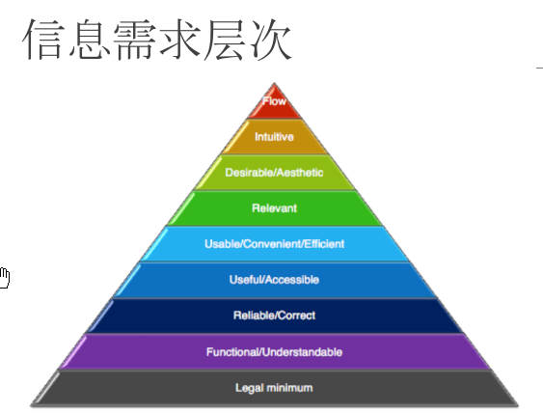
Why we need TW?

Slide 26
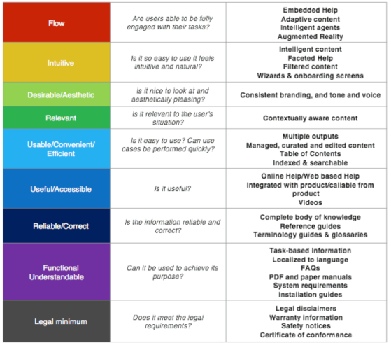

Slide 27
Make it understandable is so difficult!!!
https://yixi.tv/speech/813

Slide 28
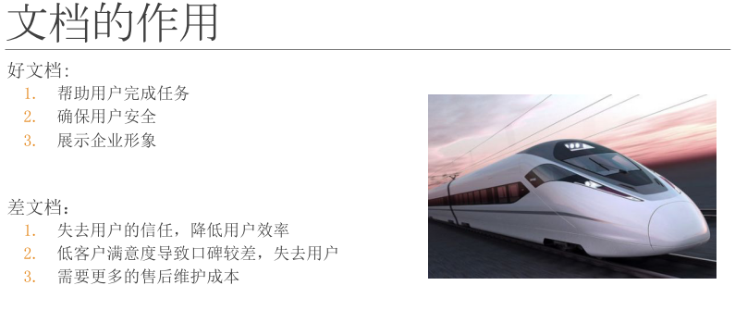

Slide 29
Okay, now it’s your turn…
Write a letter…
To whom?
About what?
When? Deadline?
How to address?(Tone?)
How to deliver? (email or written?)
Same to your paper!

Slide 30
Contents
技术写作
技术传播
中外技术传播行业

Slide 31
技术传播
Technical Communication

Slide 32
What exactly TW is? 写说明书的？
It’s not true to some extent.

Slide 33
What is Technical Communication(TW)?
Technical information is frequently communicated through documents, such as proposals, emails, reports, podcasts, computer help files, blogs, and wikis.
Although these documents are a key component of technical communication, so too is the process: writing and reading tweets and text messages, for example, or participating in videoconference exchanges with colleagues.
Technical communication encompasses a set of activities that people do to discover, shape, and transmit information.

Slide 34
The Purpose of TW
People in the working world communicate technical information for a number of purposes, many of which fall into one of two categories:
To help others learn about a subject, carry out a task, or make a decision.
To reinforce or change attitudes and motivate readers to take action.
Notice that when you communicate in the workplace, you always have a clear purpose—what you want to achieve—and an audience—one or more people who are going to read the document, attend the oral presentation, visit the website, or view the video you produce.

Slide 35
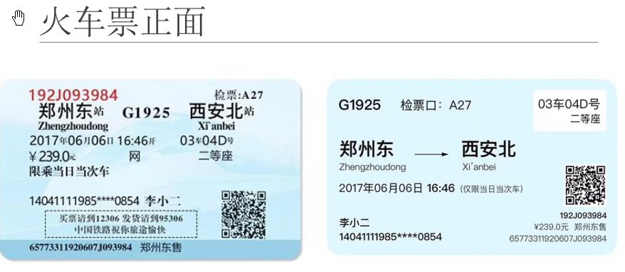

Slide 36
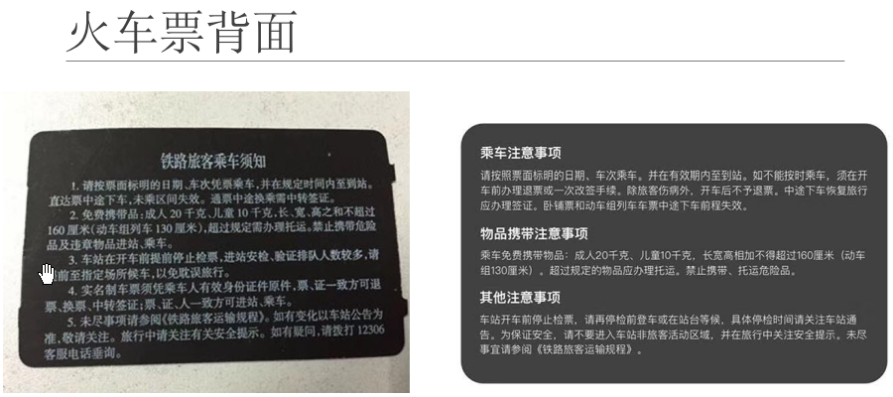

Slide 37
Arena of Valor
http://www.pipaw.com/wzry/366608.html
https://jingyan.baidu.com/article/cdddd41c93454c53cb00e1d2.html
https://mp.weixin.qq.com/s?__biz=MzU3OTM4OTkzNQ==&mid=2247484475&idx=1&sn=427771c332f81a3a4ea61072f6d2784c&chksm=fd6794bbca101dad91238c2add1d7985ac376c98106f7786aa19a70662625d16cffe92bfb149&mpshare=1&scene=23&srcid=0920fRtrOiuLy4q83ounpv8B#rd

Slide 38
Characteristics of TC
Technical Communication in User Centered
Technical documents do not show personal thought or feelings, but they can have a personality/voice.
They focus on the “need of the audience” and what they consider is important.
Technical Communication is Accessible
Technical documents need to be easy to navigate and straightforward.
Can include figures that simplify and explain a concept.
The document is accessible if people can easily understand and navigate through it to find particular information.

Slide 39
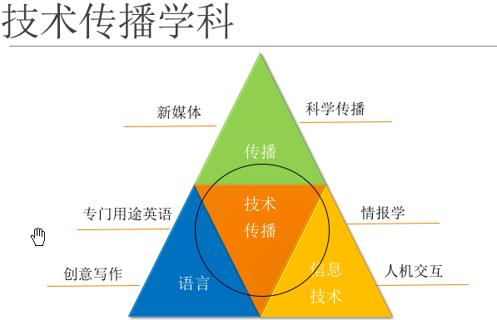

Slide 40

TW and Translation
https://book.douban.com/subject/1813841/
https://www.amazon.cn/dp/B01JODTOFK/ref=sr_1_1/461-8259839-5628811?s=books&ie=UTF8&qid=1535700967&sr=1-1&keywords=%E6%9E%AA%E7%82%AE%E3%80%81%E7%97%85%E8%8F%8C%E4%B8%8E%E9%92%A2%E9%93%81

Slide 41
TW and Translation
Translation
Transcreation/Localization
Technical Communication
https://thecontentwrangler.com/2018/08/16/dont-translate-transcreate/#

Slide 42
Contents
技术写作
技术传播
中外技术传播行业

Slide 43
3.1 国外技术传播发展

Slide 44
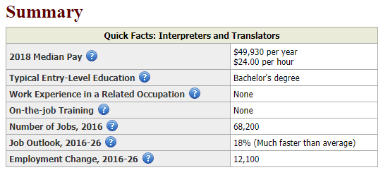
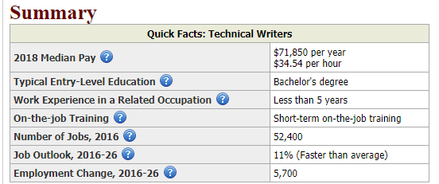
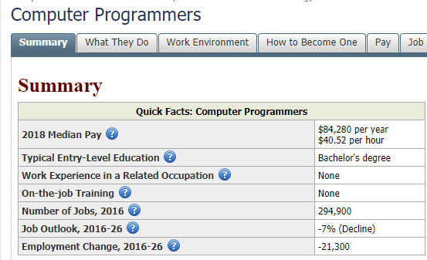
Let’s Guess
Technical Writers
Computer Programmers
Translators and Intepretors

Slide 45
TC Pay
https://www.bls.gov/ooh/media-and-communication/technical-writers.htm#tab-1

Slide 46
996 Pay
https://www.bls.gov/ooh/computer-and-information-technology/computer-programmers.htm

Slide 47
Translators/Interpreters
https://www.bls.gov/ooh/media-and-communication/interpreters-and-translators.htm#tab-1

Slide 48
Skill sets
Tekom
Summary Report for: Technical Writers
https://www.onetonline.org/link/summary/27-3042.00

Slide 49
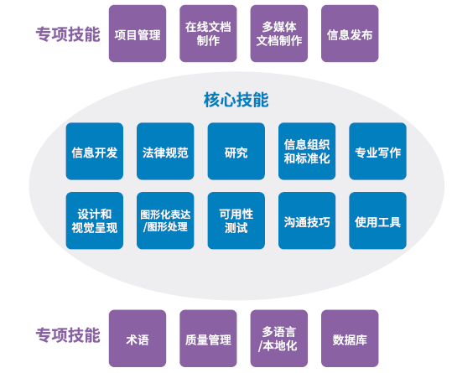
Skill sets
技术传播入门手册

Slide 50
中国技术传播行业
TC in China

Slide 51
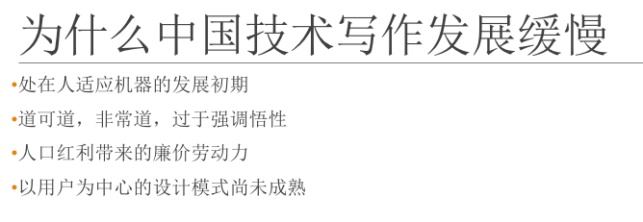

Slide 52
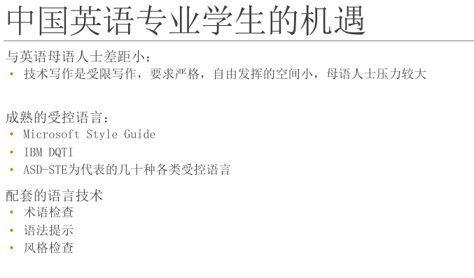

Slide 53
Goooooooooooood News!
http://mp.weixin.qq.com/s?__biz=MzU3OTM4OTkzNQ==&mid=2247483801&idx=1&sn=3e2d8cb89d14474266816ed3ac9637fd&chksm=fd679119ca10180fb22c30a133a26c2b238b1fbf476a440b7fccd7f80b6fb576b6036f66a5a1&mpshare=1&scene=23&srcid=0920Vr93FMYSSwpfbwKodU7h#rd

Slide 54
2017年中国技术传播发展报告

Slide 55
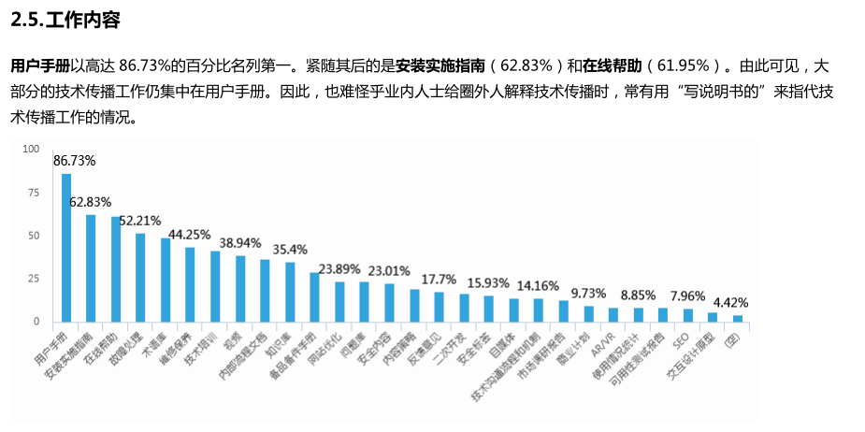

Slide 56
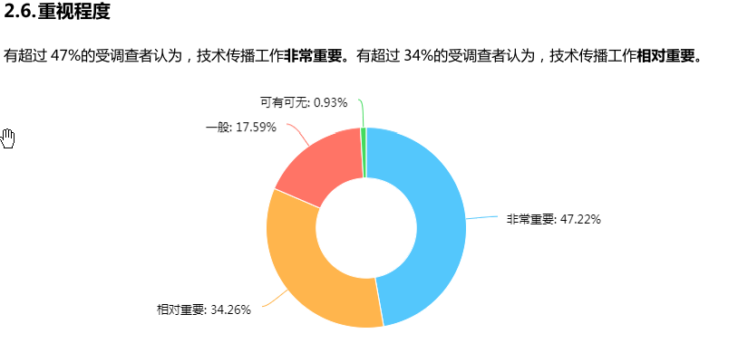

Slide 57
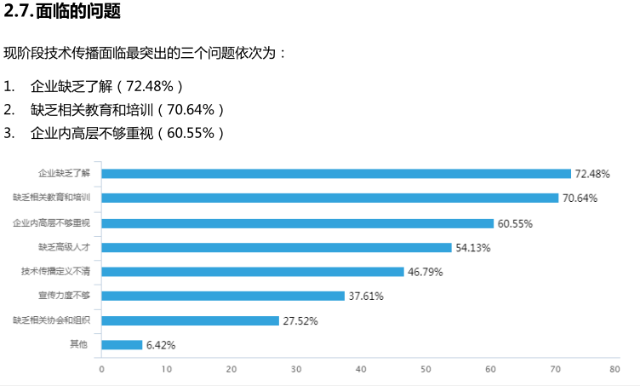

Slide 58
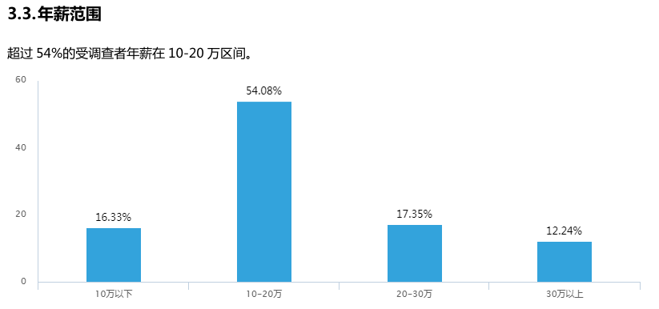

Slide 59
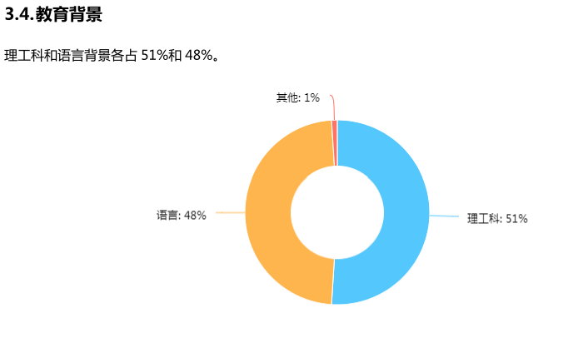

Slide 60
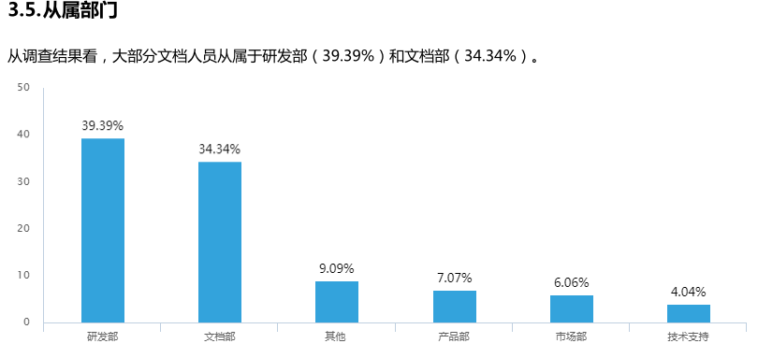

Slide 61
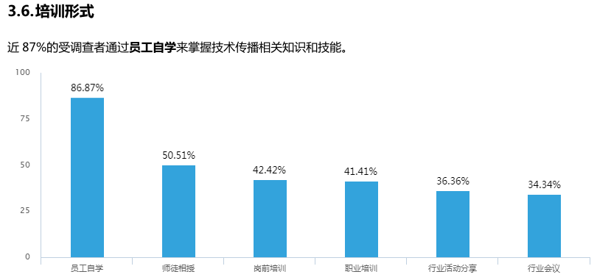

Slide 62
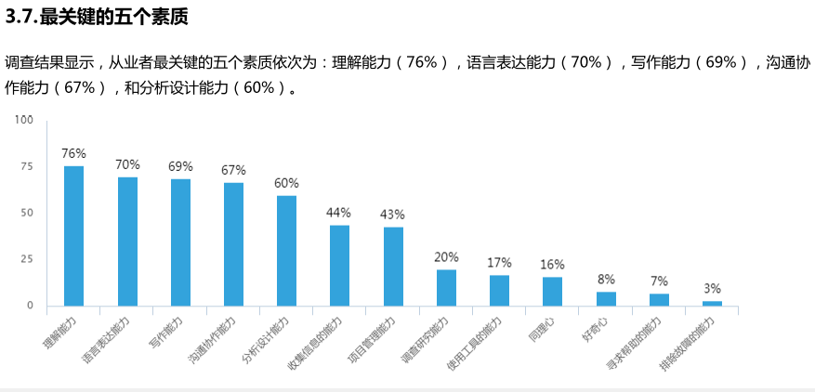

Slide 63
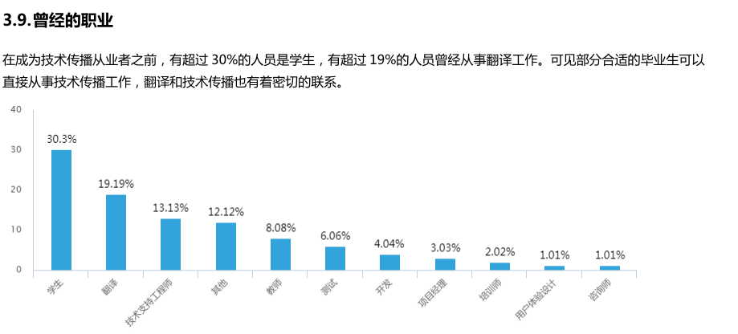

Slide 64
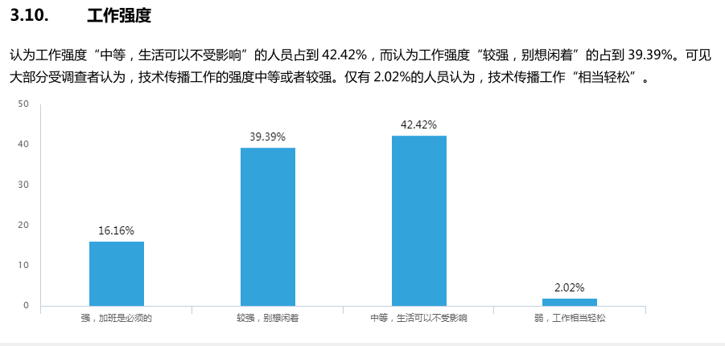

Slide 65
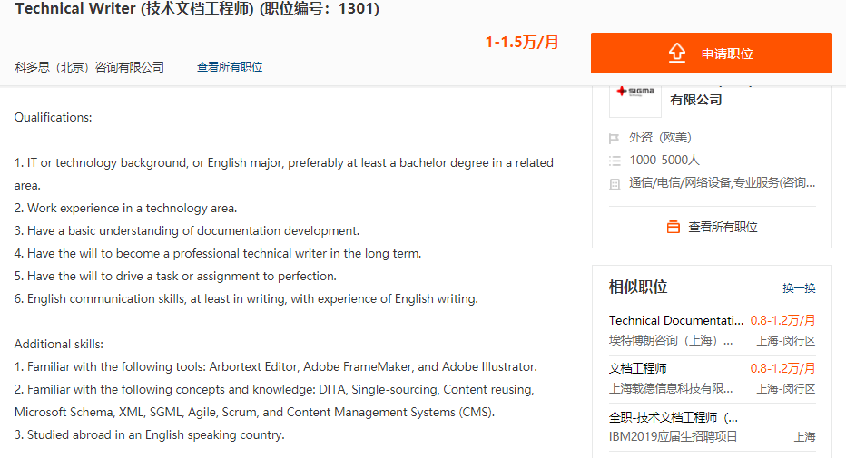

Slide 66
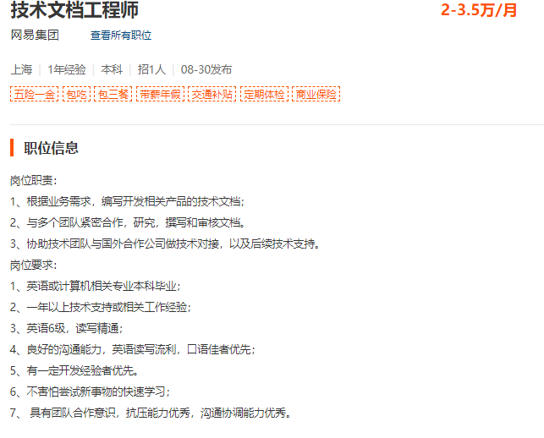

Slide 67
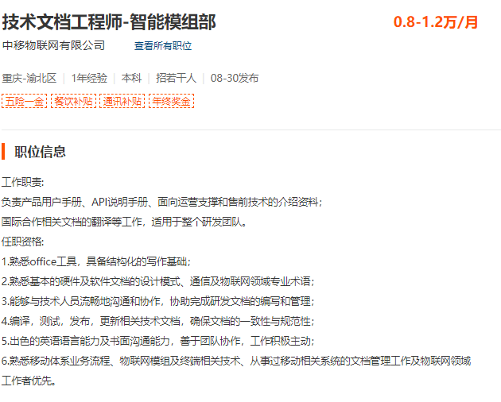

Slide 68
Contents
技术写作
技术传播
中外技术传播行业

